Slide 1

Electronic Store Sales Performance & Business Insights (2019–2020)
Analysis of ~186,000 transactions across 12 months. Purpose: surface peak hours, monthly and seasonal trends, price–quantity relationships, and operational recommendations to improve revenue and efficiency.

Slide 2

Data Wrangling & Feature Engineering
Source & Scale
Cleaning Steps
Merged 12 monthly CSVs (~186K rows). Verified schema consistency across files.
Removed rows with missing critical fields; standardized timestamps; corrected inconsistent SKUs and duplicates.
Feature Engineering
Added Month, Hour, Day of Week, Season, and Day Period (Night / Morning / Afternoon / Evening) for temporal analysis.
Result: clean, analysis-ready table enabling hourly, daily, monthly, and price-volume studies.

Slide 3

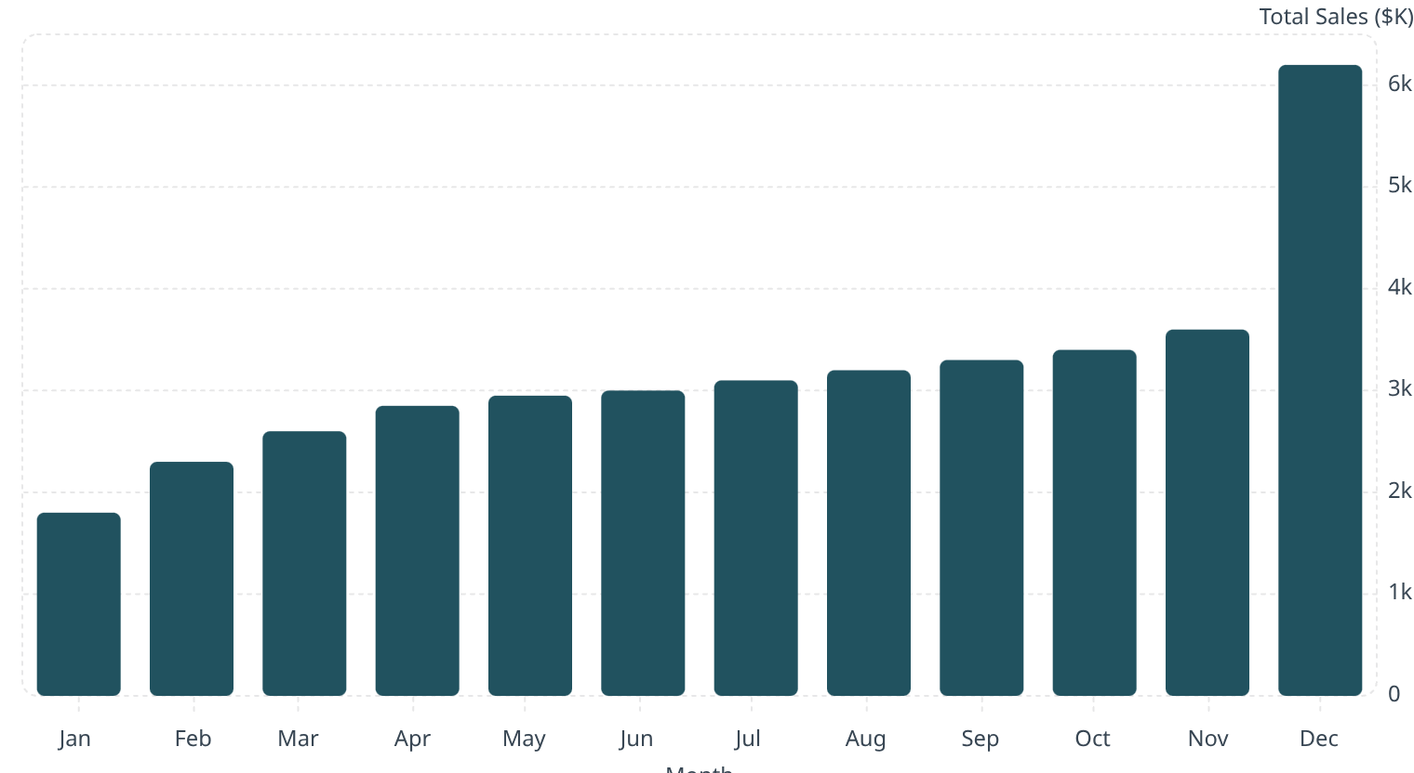
Monthly Sales Trends — 2019 Snapshot
Key points: December is the clear peak (holiday season). January is the weakest month. Total 2019 sales ~ $34.48M (annualized from monthly aggregates).

Slide 4

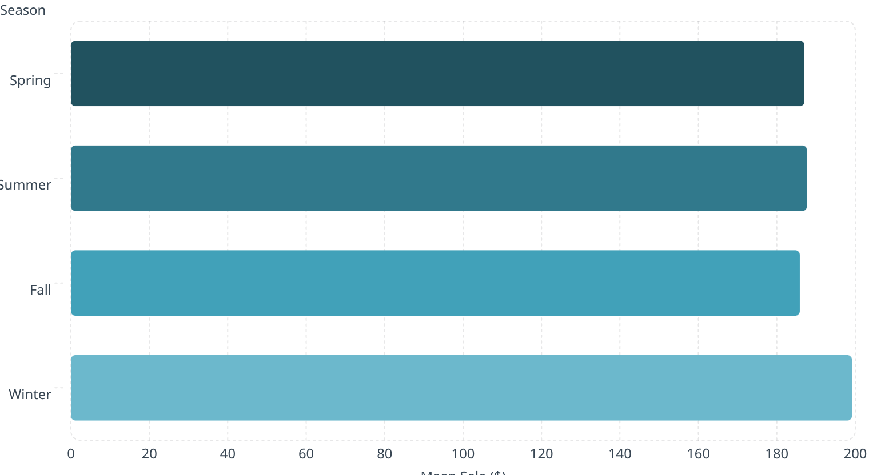

Seasonal Impact — Mean Sales per Transaction
Insight
Summer records the highest mean transaction value (187.65). Differences are small—indicating sales stability across seasons—but Summer advantage suggests targeted summer promotions can incrementally lift AOV.
Recommendation: run targeted campaigns in late spring to capitalize on summer demand.

Slide 5

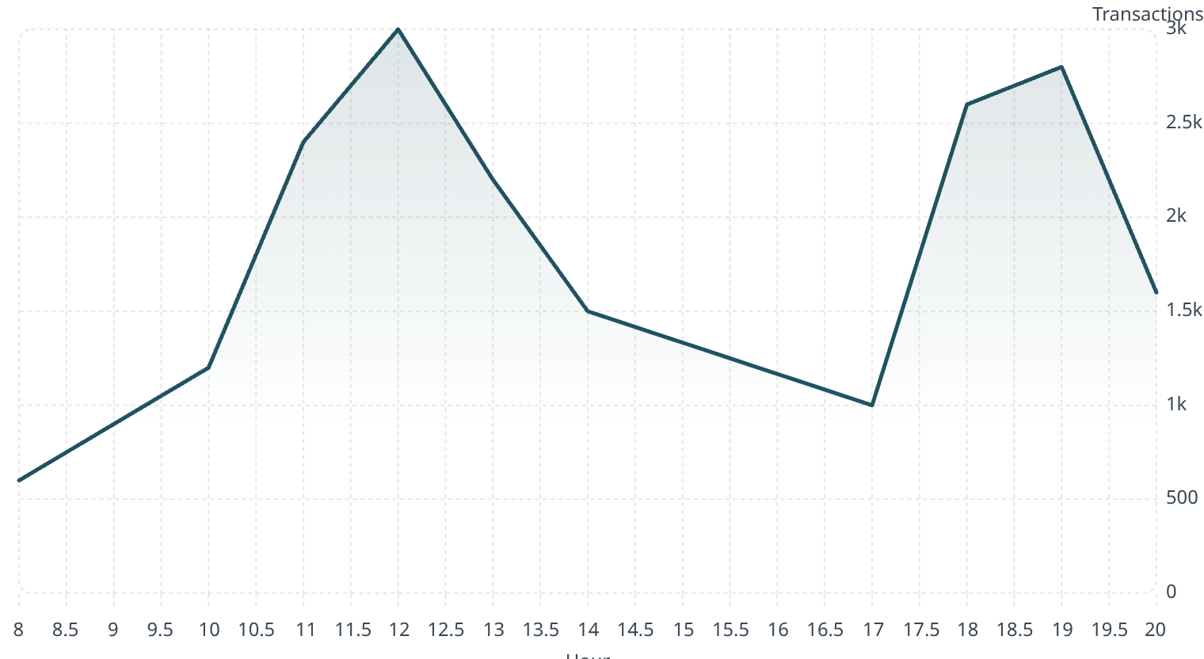
Peak Hours & Day-Period Patterns
Two clear traffic windows: 11 AM–1 PM (lunch) and 6 PM–8 PM (post-work). Recommendation: schedule paid ads and time-limited offers to run 30–60 minutes before these windows to maximize conversions.

Slide 6
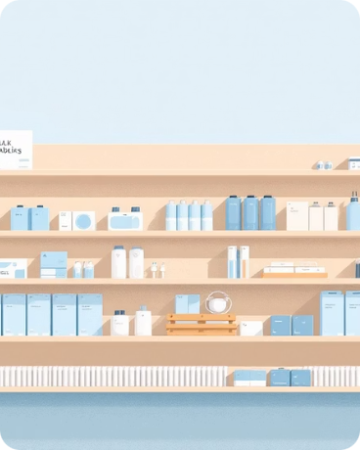

Price–Quantity Relationship & Customer Behavior
High Volume, Low Price
Low Volume, High Price
Strong negative correlation: low-priced items (cables, batteries) sell in larger quantities and drive unit volume.
Expensive items (laptops, monitors) sell fewer units but contribute disproportionately to revenue and margin.
Behavioral insight: mean sale value is nearly identical on weekdays vs weekends (~$185.51 vs $185.44) — purchases are needs-driven rather than leisure-driven. Use this to normalize staffing and promotions across the week.

Slide 7

Key Recommendations & Next Steps
Inventory Planning
Pricing & Promotions
Increase stock of fast-moving, low-cost SKUs ahead of December peak. Maintain safety stock for high-ticket items to avoid lost revenue.
Introduce volume-based discounts for accessories to boost basket size; use dynamic pricing for seasonal demand spikes.
Operations & Staffing
Marketing Timing
Shift staffing to cover 11 AM–1 PM and 6 PM–8 PM windows. Cross-train staff for checkout and product demos during peak periods.
Deploy targeted ads 30–60 minutes before peak windows and run December inventory preparation campaigns starting in October.
Immediate next step: prioritize a Q4 readiness plan — inventory forecast, ad schedule, and staff rota to capture peak-season demand efficiently.

